Slide 1
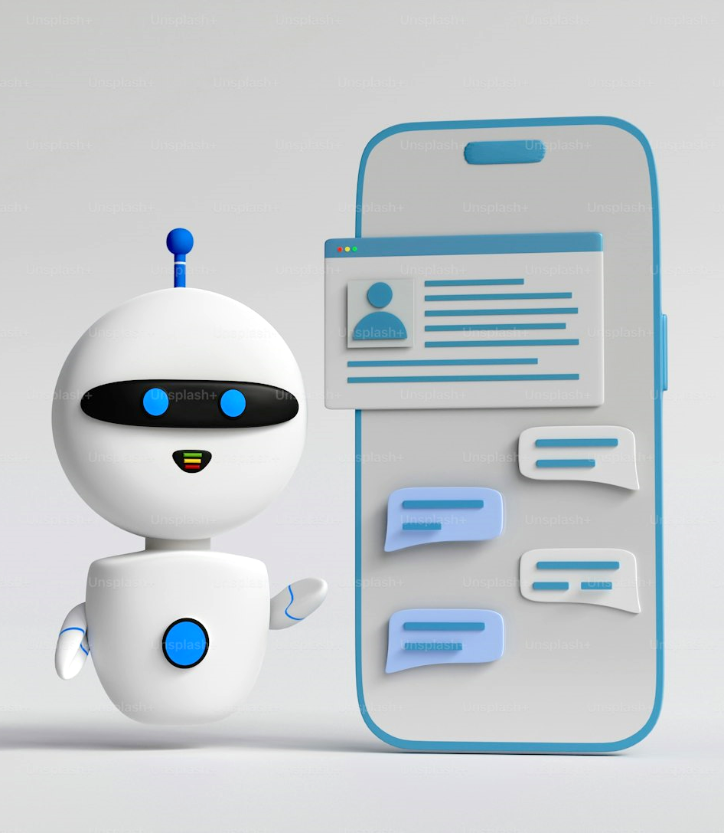
Chat Bot using Python
Abhilash Chutia
CSM23010
Bishal Sharma
CSM23024

Slide 2
Agenda
Introduction
Types & Characteristics
Requirements, Tools & Software
Advantages & Use Cases
Challenges & Future Goals

Slide 3

Introduction
A chatbot is a piece of computer program that can act as a human being and simulate conversation.
These are commonly used in customer care, company FAQ and now more commonly in AI with the support of Machine Learning.
Example: ChatGPT, Gemini

Slide 4


Chat Bot Types & Characteristics
TYPES
& CHARACTERISTICS

Slide 5
Characteristics
Casual Conversation Flow
A Chat Bot has the ability to converse with a human and maintain the context of the conversation.
Integration
The Chat Bot can be connected to various platforms such as websites, social media platforms and mobile applications.
Learning Capabilities
The ability to analyze and learn for conversations.
Personalization
The ability to tailor responses to user preference and chat history.

Slide 6

Types of Chatbots
Rule Based Chatbots
Open Ended/AI-Powered Chatbots
Rely on Scripts
Uses If-Then login to handle specific queries
Can only handle simple and repetitive tasks
Cannot handle complex or random inputs
Less Flexible
Uses Machine learning and Natural Language Processing
Can understand and respond to a wide range of queries
Adaptable
Can be personalized
Can host human – like conversations

Slide 7
Requirements: Tools & Softwares
Hardware Requirements
Processor:
Dual Core Processor
(More cores can improve performance,
especially for NLP models)
Ram:
Minimum 4GB
(More is recommended for a larger dataset)
Storage:
SSD (preferred)
20GB Space required
(For Dataset storage)
GPU:
Recommended (Not Necessary)
Faster Training

Slide 8
Requirements: Tools & Softwares
Software Requirements
Operating System:
Any OS that supports Python (e.g., Windows, macOS, Linux).
Python Version:
Python 3.7 or higher.
IDE/Code Editor:
Visual Studio Code, PyCharm, or any preferred code editor.
Virtual Environment (Optional):
venv or virtualenv to manage project dependencies.
Database (Optional):
SQLite, MySQL, or MongoDB for persistent data storage.

Slide 9
Requirements: Tools & Softwares
Python Libraries
Natural Language Processing (NLP):
nltk: Natural Language Toolkit for text processing.
spaCy: For advanced NLP tasks like named entity recognition.
transformers: Hugging Face library for transformer models like BERT, GPT.
Machine Learning & Deep Learning:
scikit-learn: For traditional machine learning algorithms.
tensorflow or pytorch: For deep learning models.
Web Framework (for deploying chatbot):
React.js
Flask or Django: To create a web interface or API.
Messaging Platforms Integration (Optional):
python-telegram-bot: For Telegram bot integration.
discord.py: For Discord bot integration.

Slide 10
Advantages and Use Cases
Advantages
Always On:
Available 24/7, ready to assist.
Cost-Effective:
Automate routine tasks, reducing staffing costs.
Scalable:
Handle multiple conversations at once.
Consistent:
Provide reliable, uniform responses.
Insightful:
Gather data to understand customer needs.
Personalized:
Tailor interactions based on user preferences.
Engaging:
Keep users interested and involved.

Slide 11
Advantages and Use Cases
Use Cases
Customer Support:
Quick help with common questions.
Shopping:
Product recommendations and order tracking.
Healthcare:
Appointment scheduling and medication reminders.
Banking:
Transactions, balance checks, and fraud alerts.
Travel:
Trip bookings and updates.
Education:
Admissions guidance and homework help.
Real Estate:
Finding and scheduling property visits.

Slide 12
Challenges faced by Chat Bots
Ambiguity and Context:
Understanding complex language and maintaining context in conversations.
Limited Responses:
Providing natural, human-like interactions within predefined limits.
Technical Limitations:
Integrating with systems, processing real-time queries, and scaling to high volumes.
Security and Privacy:
Protecting user data and complying with regulations.
Training and Maintenance:
Acquiring sufficient data and keeping chatbots up-to-date.
Bias and Ethics:
Avoiding biases in training data and ensuring ethical use.
User Trust and Adoption:
Building trust and educating users about chatbot capabilities.
Multilingual Support:
Understanding and responding to different languages and cultures.

Slide 13




Thank you
Abhilash Chutia
CSM23010
Bishal Sharma
CSM23024

